Slide 1
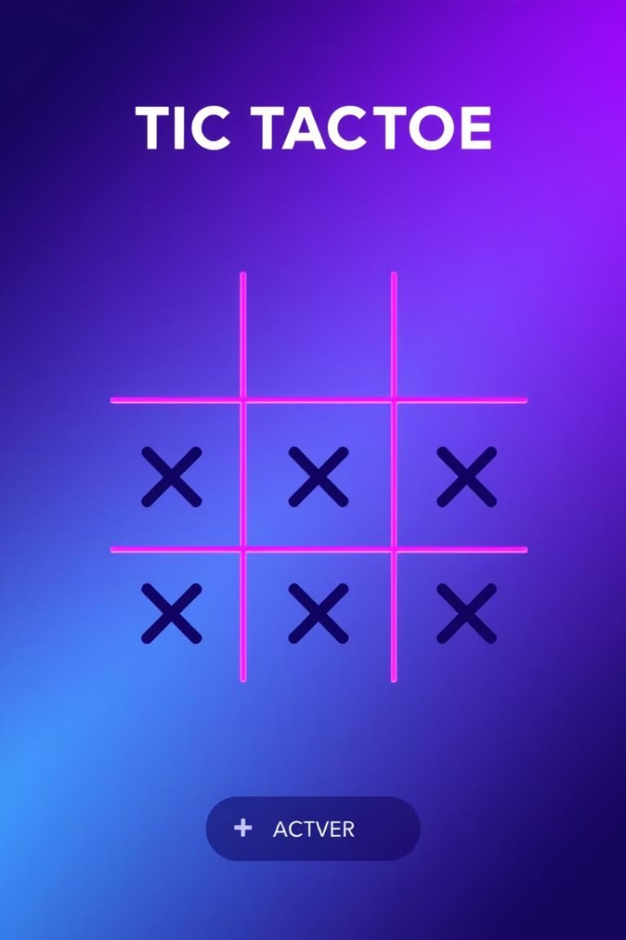
Tic Tac Toe Game
C++
Sagarmatha Engineering College
PRESENTERS : RIMAN MAHARJAN
(SEC080BEI015)
SUFAL KC
(SEC080BEI017)

Slide 2

Libraries Used
1
iostream
2
stdio.h
Standard input/output stream.
Standard input/output functions.
3
stdlib.h
4
graphics.h
Standard utility functions like memory allocation.
Provides graphics functions for drawing shapes and text.

Slide 3
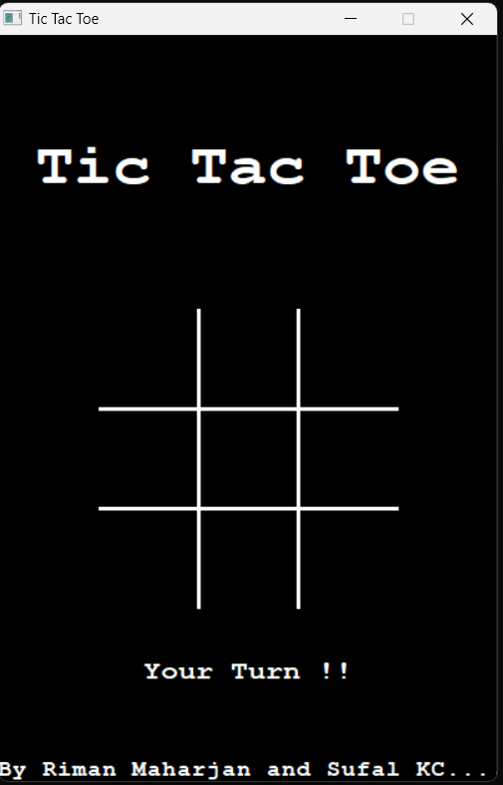
Graphics Part
design(); Function
Mouse Interaction
User-defined function.
Draws the initial layout, including the grid and title.
Captured using GetAsyncKeyState() and GetCursorPos() to detect clicks.
600
Graphics Functions
settextstyle(int, int , int): Sets text style.
int main(){
initwindow(400,600,"Tic Tac Toe");
….
closegraph();
}
outtextxy(x, y, “text”): Displays text at coordinates.
line(x1, y1, x2, y2):
Draws lines for the grid.
400

Slide 4
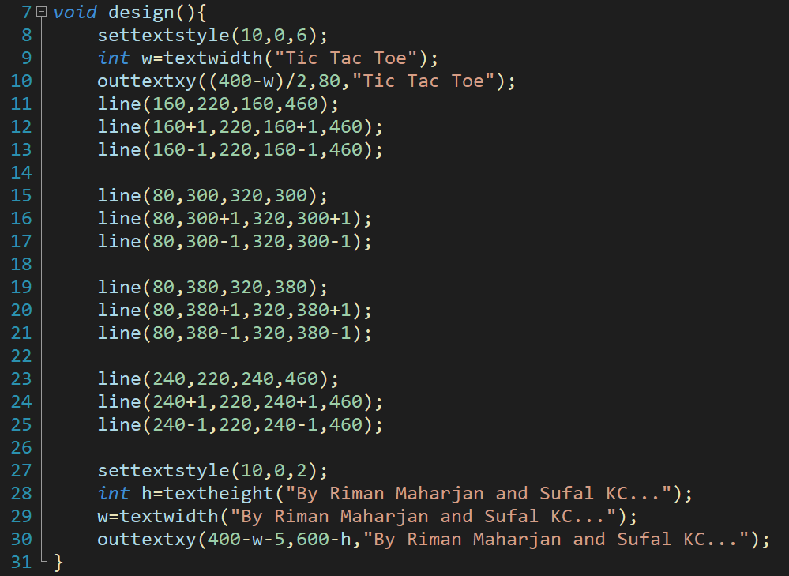
Function design();
240
240
80
80
Functions Used
How it Works
line() takes 4 coordinates as parameter.(starting x, y and ending x, y)
outtextxy() prints text in desired coordinate
Sets text style, draws grid lines, and displays the title.

Slide 5
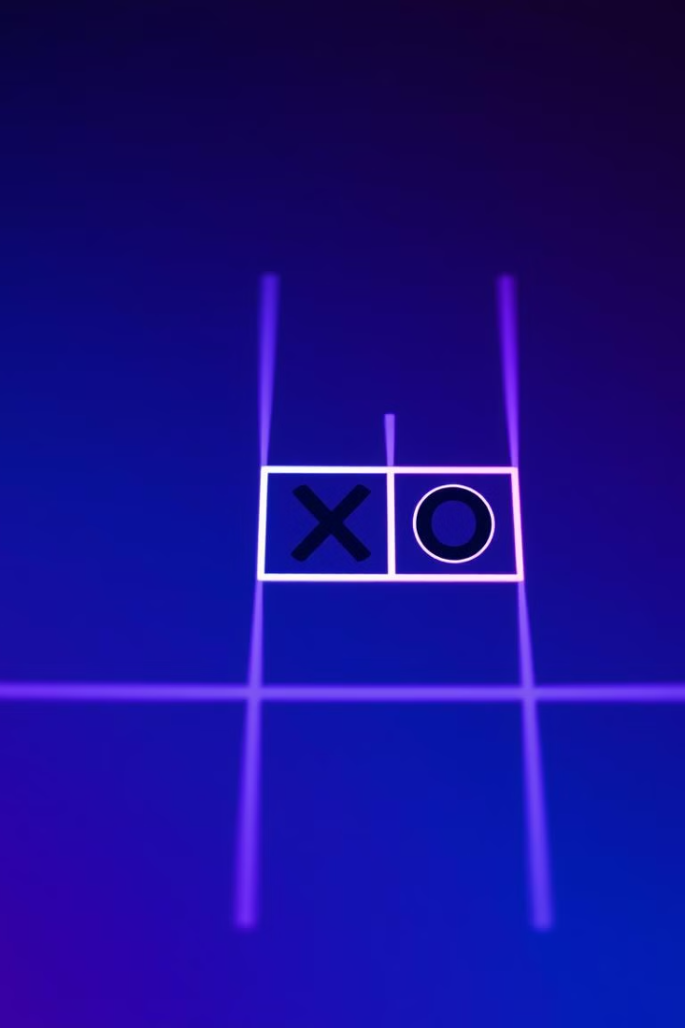



Function dis(int turn, int p)
Purpose
Displays 'X' or 'O' on the board.
Logic
Determines mark based on turn and position (p).
How it Works
If turn 1, it’s ‘X’ turn else it’s ‘O’ turn.
P is position in grid ie. 1,2,3…or 9.
Writes ‘X’ or ‘O’ in that position by centering and upscaling it.

Slide 6




Mouse Interaction
GetAsyncKeyState()
Detects mouse clicks using VK_LBUTTON.
GetCursorPos()
while(true){ if(GetAsyncKeyState(VK_LBUTTON))
{
GetCursorPos(&pos);
long X=mousex();
long Y=mousey();
….}}
Retrieves cursor position.
mousex() and mousey() gives
x and y coordinates of the mouse pointer when it was clicked.
Mapping
Checks if x y coordinate lies in any empty cell.
Maps position to grid cells and updates game state.

Slide 7
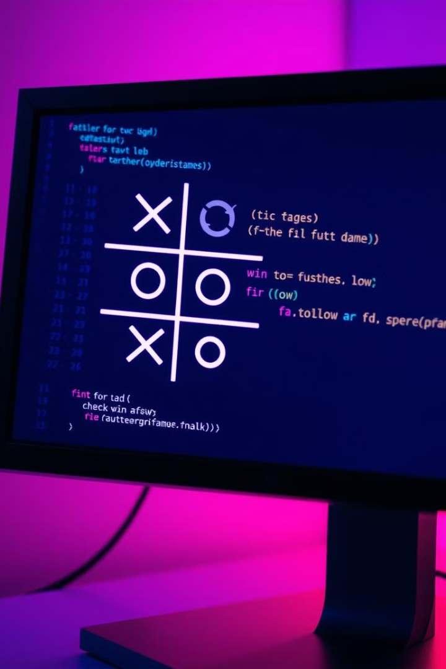
Logic Part
Function
Purpose
\`fun(char \*a)\`
Checks for a win, draw, or ongoing game.

Slide 8

Computer's Defense Strategy
1
Player's Move
The computer checks if the player has two in a row.
2
Blocking Move
If found, the computer places its 'O' to block.
3
Code Snippet
\`if(cnt\[i\]==2 && p\[i\]!=-1)\`

Slide 9

Computer's Attack Strategy
1
Analyzing Moves
The computer analyzes potential moves to create a winning line.
2
Winning Move
If a winning move is possible, it places an 'O' to win.
3
Code Snippet
\`if(a\[i\]=='O') { cnt\[i/3\]++; ... }\`

Slide 10

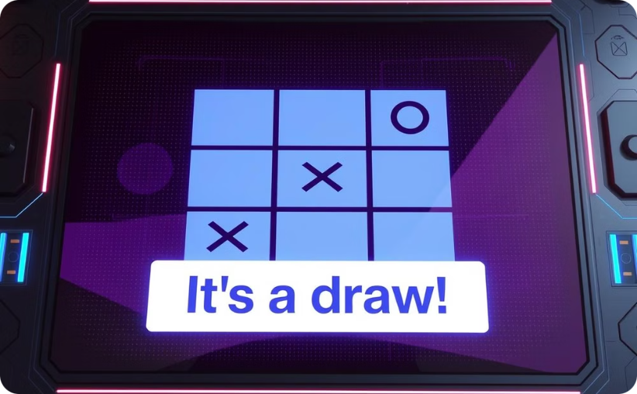
Checking Win, Draw, or Loss
Player 1 Win
Draw
The function returns: \`1\` for player 1 win.
The function returns: \`0\` for ongoing, \`1\` for player 1 win, \`2\` for player 2 win.

